Slide 2
The Spirit of the Sovereign Lord is on me, because the Lord has anointed me to proclaim good news to the poor. He has sent me to bind up the broken hearted, to proclaim freedom for the captives and release from darkness for the prisoners,^{[a]} ² to proclaim the year of the Lord’s favour and the day of vengeance of our God, to comfort all who mourn,

Slide 3
³ and provide for those who grieve in Zion— to bestow on them a crown of beauty instead of ashes, the oil of joy instead of mourning, and a garment of praise instead of a spirit of despair. They will be called oaks of righteousness, a planting of the Lord for the display of his splendour.

Slide 4
⁴ They will rebuild the ancient ruins and restore the places long devastated; they will renew the ruined cities that have been devastated for generations.
Isaiah 61:1-4
“Today this scripture is fulfilled in your hearing.”
Luke 4:21

Slide 5
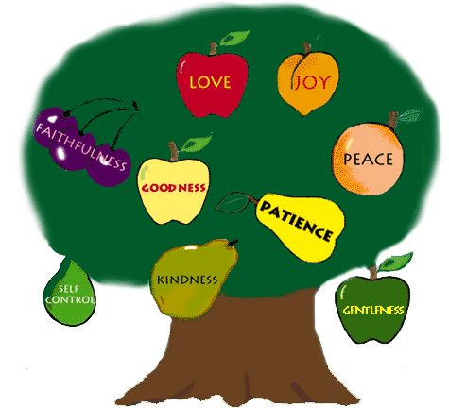
But the fruit of the Spirit is love, joy, peace, patience, kindness, goodness, faithfulness, ²³ gentleness and self-control. Against such things there is no law.
Galatians 5:22-23

Slide 6
Can you think of a time where you or someone else has brought beauty to a situation?

Slide 7
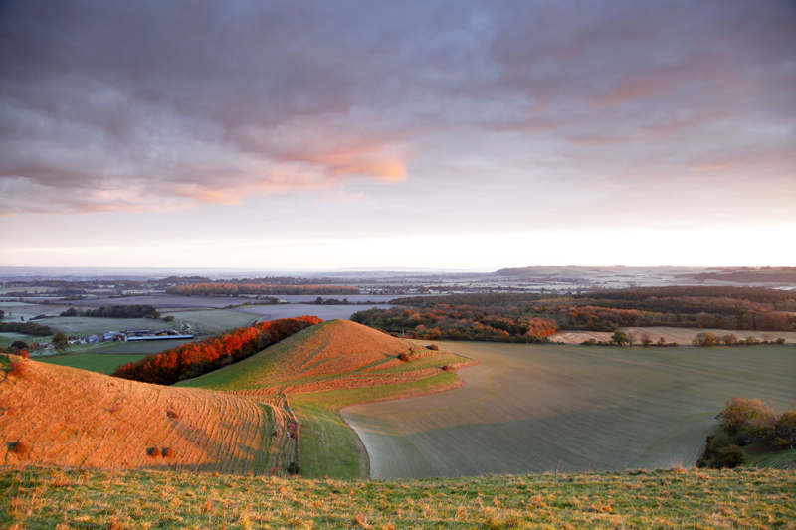
Hat Tip – Chris Lock Photography

